Slide 1

Chapter 4
Introduction to Programming for Science Educators
Fundamental Programming Concepts and Scientific Applications
Computing Science for Science Teaching
วิทยาศาสตร์คอมพิวเตอร์สำหรับการสอนวิทยาศาสตร์
Author
Dr. [Author Name]
Affiliation
[Institution Name]

Slide 2

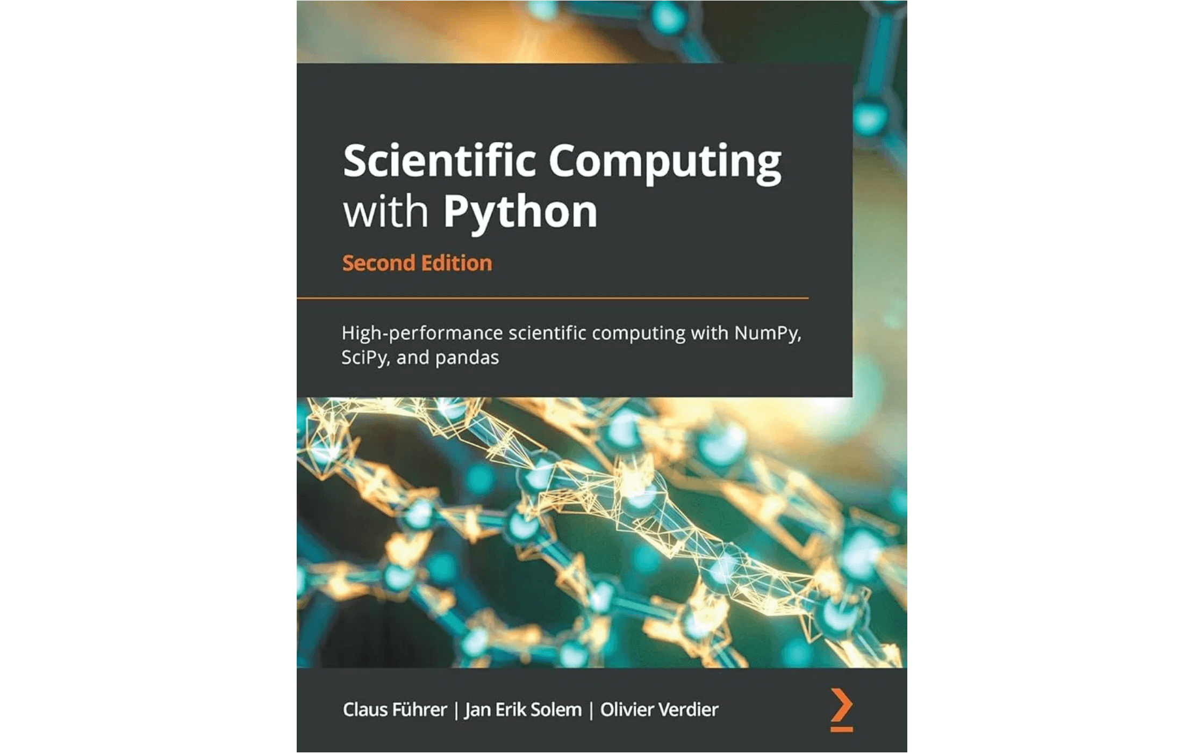
Why Programming for Science Educators?
▸
Enhance Scientific Literacy:
Understand how computational models and analyses are performed, fostering a deeper appreciation for modern scientific methods.
▸
Create Engaging Learning Experiences:
Develop interactive simulations, data analysis tools, and problem-solving activities for students.
▸
Analyze and Visualize Data:
Process large datasets from experiments or public sources, revealing patterns and insights that might be missed with traditional methods.
▸
Model Complex Systems:
Simulate natural phenomena that are difficult or impossible to observe directly, providing a powerful way to explore scientific concepts.
▸
Foster Critical Thinking:
Encourage students to think algorithmically, break down problems, and debug solutions, mirroring the iterative nature of scientific research.
Programming is no longer optional—it is a fundamental skill for modern science education.

Slide 3

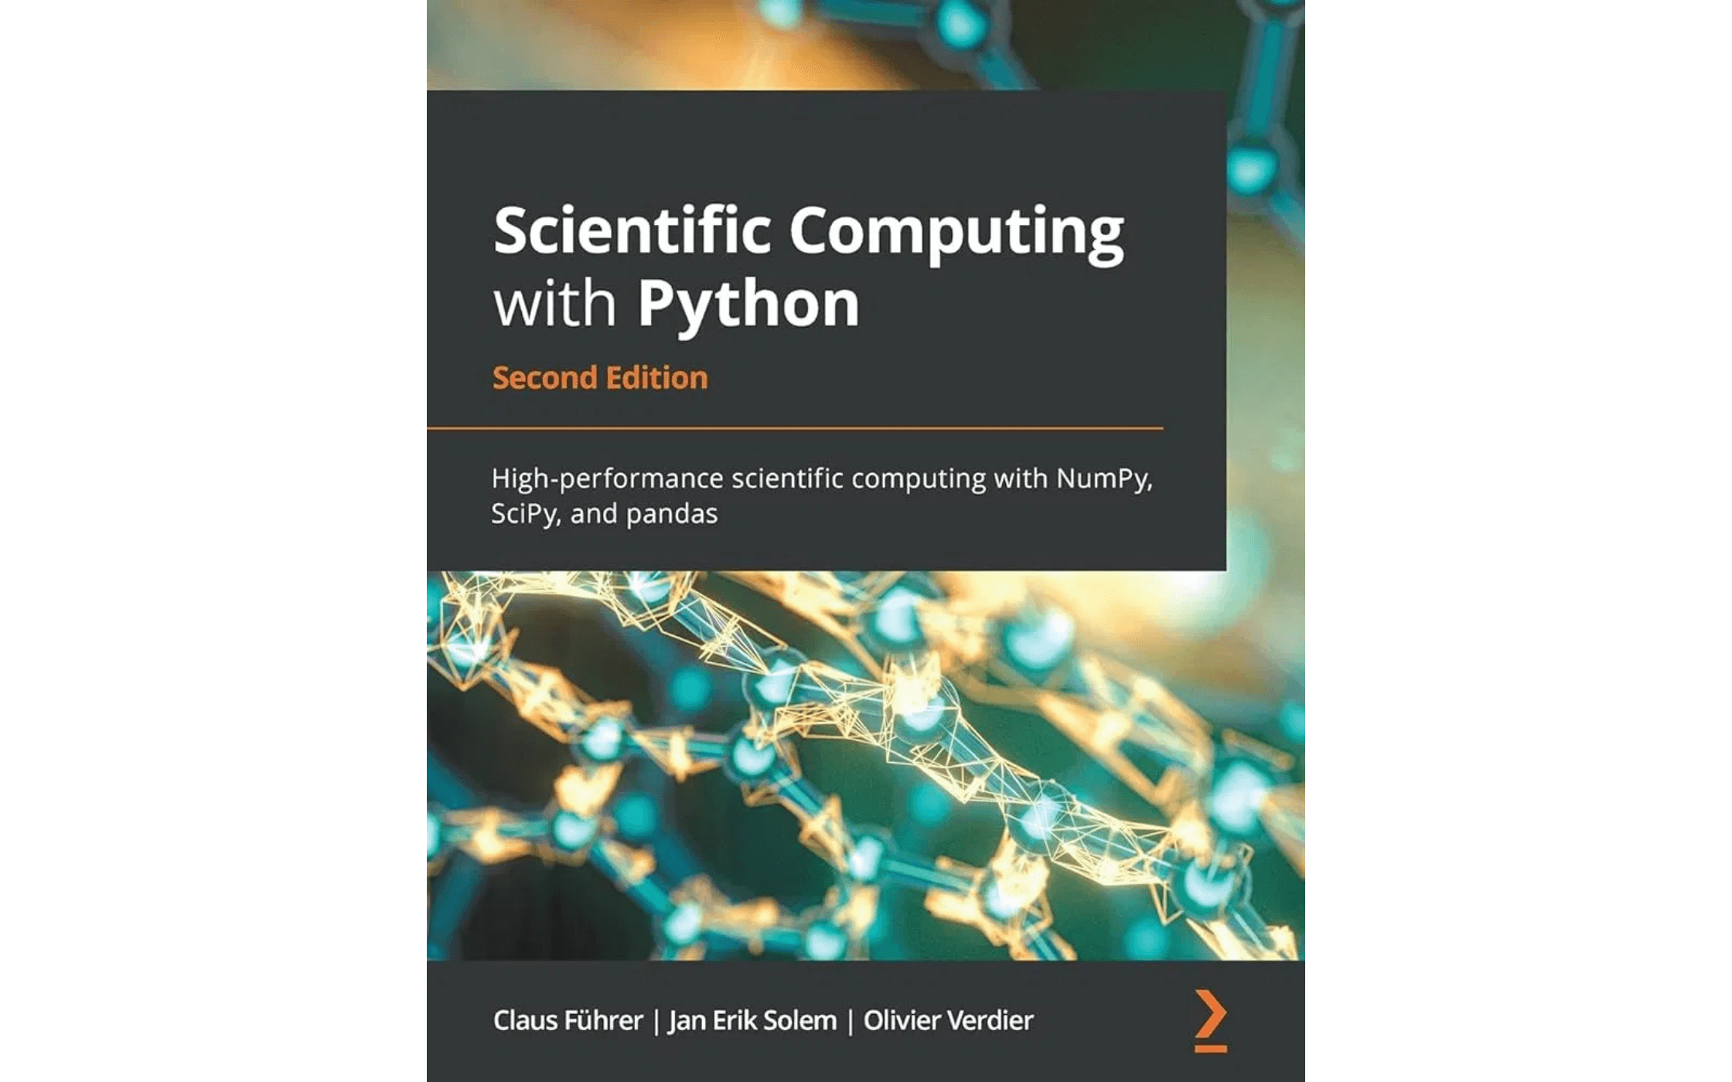
The Power of Python for Science
▸
Readability:
Beginner-friendly syntax that closely resembles natural language, making it ideal for educators and students.
▸
Scientific Libraries:
Extensive ecosystem including NumPy, SciPy, Pandas, and Matplotlib for numerical computing and visualization.
▸
Wide Adoption:
Widely used in scientific research, data science, and educational institutions worldwide.
▸
Versatility:
Suitable for data analysis, visualization, simulation, machine learning, and general-purpose programming.
▸
Community Support:
Strong community, extensive documentation, and abundant online resources for learning and problem-solving.
Key Libraries
NumPy (numerical computing), Pandas (data manipulation), Matplotlib (visualization), SciPy (scientific functions)

Slide 4

Variables and Data Types: Building Blocks of Programming
Fundamental Concepts
Variables are named storage locations that hold values, like labeled boxes for storing information. Data types classify the kind of value a variable can hold, determining what operations are possible.
Data Type 1
Data Type 2
int (Integer)
float (Floating-point)
Description
Description
Whole numbers without decimal points
Numbers with decimal points
Example
Example
num_trials = 10
temperature = 37.5
Scientific Use
Scientific Use
Counting discrete items like trials, samples, or organisms
Representing continuous measurements like temperature, mass, or velocity
Data Type 3
Data Type 4
str (String)
bool (Boolean)
Description
Description
Sequences of characters (text)
Truth values: True or False
Example
Example
species = "Homo sapiens"
is_valid = True
Scientific Use
Scientific Use
Storing labels, descriptions, and DNA sequences
Logical operations and control flow in data validation
Understanding data types is crucial because different types behave differently and require specific operations. Using the correct data type ensures accurate calculations and efficient programming.

Slide 5

Operators and Expressions: Performing Calculations
Operators are symbols that perform operations on values and variables. Expressions combine values and operators to produce results. Understanding operators is essential for scientific calculations.
Arithmetic Operators
Comparison Operators
Operations
Operations
+, -, *, /, %, ** (addition, subtraction, multiplication, division, modulo, exponentiation)
==, !=, <, >, <=, >= (equal, not equal, less than, greater than, less/equal, greater/equal)
Example
Example
velocity = distance / time
if pH > 7: acidic = False
Logical Operators
Assignment Operators
Operations
Operations
AND, OR, NOT (combine conditions, evaluate truth values)
=, +=, -=, *=, /= (assign, add-assign, subtract-assign, etc.)
Example
Example
if temp > 100 AND pressure > 1: boiling = True
count += 1 # Increment count
Order of Operations (PEMDAS)
Parentheses, Exponents, Multiplication & Division (left to right), Addition & Subtraction (left to right). This ensures consistent and correct calculation results in scientific computations.

Slide 6

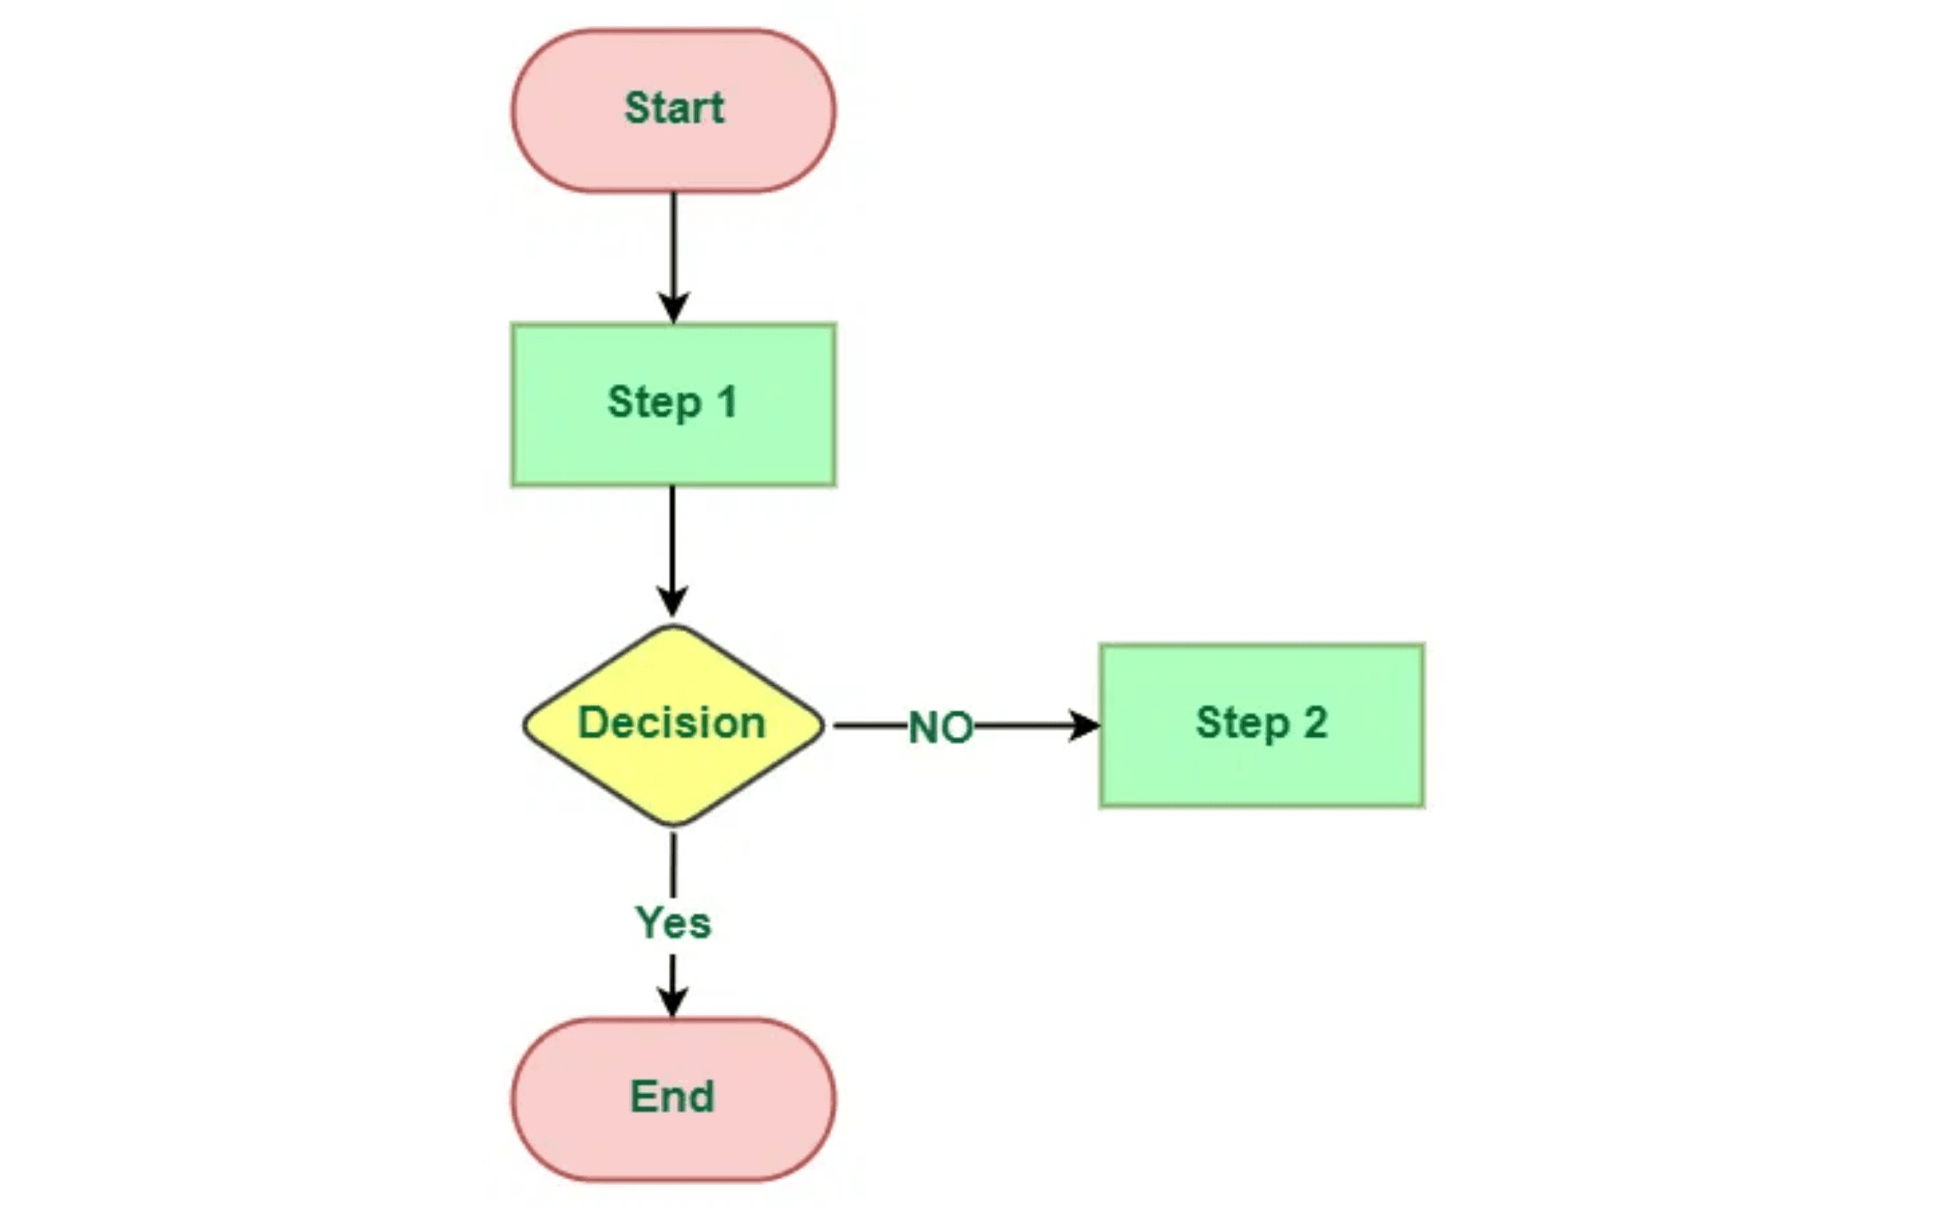
Control Structures - Conditionals: Making Decisions in Code
Conditionals allow programs to make decisions based on conditions. They execute different code blocks depending on whether a condition is true or false.
▸
if statement:
if temperature > 100: print("Boiling")
Executes code if a condition is true. Example:
▸
else statement:
else: print("Not boiling")
Executes alternative code if the if condition is false. Example:
▸
elif statement:
elif pH < 7: print("Acidic")
Tests multiple conditions in sequence. Example:
▸
Nested conditionals:
Conditionals within conditionals for complex logic. Useful for multi-level data validation.
Scientific Applications
Data validation: Check if measurements are within acceptable ranges. Experimental control: Activate equipment based on sensor readings. Classification: Categorize samples based on properties.

Slide 7


Control Structures - Loops: Repeating Code Blocks
Loops allow code to repeat automatically, essential for processing datasets and running simulations in scientific research.
For Loops
Iterate through sequences (lists, arrays) or repeat a fixed number of times.
for i in range(10):
print(i)
While Loops
Repeat code block while a condition remains true. Useful for iterative processes.
while temperature > 100:
cool_down()
Loop Control Statements
break: Exit loop immediately. continue: Skip to next iteration. Nested loops: Loops within loops for multi-dimensional data processing.
Scientific Applications
Processing experimental datasets, calculating averages, running simulations, analyzing time-series data, and automating repetitive calculations.

Slide 8

Functions and Modular Programming
Functions are reusable blocks of code that perform specific tasks. Modular programming breaks complex programs into smaller, manageable functions, improving code quality and maintainability.
Concept 1
Concept 2
Function Definition & Parameters
Return Values & Output
Functions are defined with a name and accept parameters (inputs) that allow customization of behavior.
Functions return results to the caller, enabling data processing and result communication.
Example
Example
def calculate_mean(values):
return sum(values) / len(values)
Concept 3
Concept 4
Documentation & Docstrings
Scope & Variable Lifetime
Functions should include clear documentation explaining purpose, parameters, and return values.
Variables defined in functions have local scope, preventing unintended interactions with global variables.
Example
Benefit
"""Calculate mean of values"""
Avoids naming conflicts and side effects
Benefits of Modular Programming
Reusability:
Functions can be used multiple times, reducing code duplication
Readability:
Smaller functions are easier to understand and maintain
Testability:
Individual functions can be tested independently for correctness
Maintainability:
Changes to one function don't affect others

Slide 9


Working with Data Structures: Organizing Scientific Data
Data structures are organized ways to store and manage collections of data. Choosing the right data structure is crucial for efficient scientific computing.
▸
Lists:
measurements = [23.5, 24.1, 23.8]
Ordered collections of items that can be modified. Example:
▸
Tuples:
Immutable sequences that cannot be changed after creation. Useful for fixed data sets.
▸
Dictionaries:
sample = {'pH': 7.2, 'temp': 25}
Key-value pairs for structured data. Example:
▸
Arrays (NumPy):
Efficient numerical arrays for mathematical operations and large datasets.
File Input/Output
Read data from files (CSV, JSON, text) and write results back to files for persistence and sharing of scientific data.
Scientific Applications
Storing experimental results, organizing sensor data, managing sample information, and preserving data for analysis and reproducibility.

Slide 10

Introduction to Libraries and Modules
Libraries (also called packages) are collections of pre-written code that extend Python's functionality. Modules are individual files containing reusable code. Leveraging libraries accelerates development and improves code quality.
How to Import Libraries
import numpy as np
from pandas import DataFrame
import matplotlib.pyplot as plt
Library 1
Library 2
NumPy
Pandas
Purpose
Purpose
Numerical computing and array operations
Data manipulation and analysis
Key Functions
Key Functions
array(), mean(), std(), dot()
DataFrame(), read_csv(), groupby()
Library 3
Library 4
Matplotlib
SciPy
Purpose
Purpose
Data visualization and plotting
Scientific functions and algorithms
Key Functions
Key Functions
plot(), scatter(), bar(), show()
stats, optimize, integrate
Getting Started with Libraries
Start with NumPy for numerical computing, Pandas for data analysis, and Matplotlib for visualization. These three libraries form the foundation of scientific Python programming. As you advance, explore SciPy for specialized scientific algorithms and other domain-specific libraries.

Slide 11

Practical Programming for Science - Case Studies
Real-world applications: The programming concepts from this chapter are actively used in scientific research. Here are three compelling examples demonstrating how programming solves authentic scientific problems.
Case Study 1
Case Study 2
Case Study 3
Temperature Data Analysis
Population Dynamics Simulation
DNA Sequence Processing
Context
Context
Context
Climate scientists analyze millions of temperature readings from sensors
Ecologists use computational models to simulate how populations grow,
Bioinformaticians analyze DNA sequences to identify genes, detect
across the globe to understand climate patterns and trends.
interact, and respond to environmental changes over time.
mutations, and understand evolutionary relationships between organisms.
Programming Concepts
Programming Concepts
Programming Concepts
Variables store temperature values. Loops process each measurement.
Variables represent population sizes and parameters. Loops simulate time
Strings store DNA sequences. Loops scan for patterns. Conditionals
Conditionals filter anomalies. Functions calculate statistics (mean, standard
steps. Conditionals model birth/death rates. Functions encapsulate model
identify mutations. Functions perform sequence alignment and
deviation).
logic.
comparison.
Practical Application
Practical Application
Practical Application
Automated analysis of sensor networks, real-time anomaly detection,
Predicting species extinction risk, testing conservation strategies,
Gene discovery, mutation detection, phylogenetic analysis, personalized
trend visualization.
understanding ecosystem dynamics.
medicine applications.
These case studies demonstrate that programming is not just a technical skill—it is a fundamental tool that enables scientists to solve complex problems, discover new insights, and advance human knowledge across diverse scientific disciplines.

Slide 12

Empowering Students Through Programming
Key Takeaway 1
Key Takeaway 2
Programming Enhances Scientific Literacy
Python is Accessible and Powerful
Understanding how computational models and analyses are performed deepens appreciation for modern scientific methods and computational approaches.
Python's readable syntax and extensive scientific libraries make it ideal for science education, enabling students to focus on concepts rather than syntax.
Key Takeaway 3
Key Takeaway 4
Programming Mirrors Scientific Thinking
Practical Skills for Modern Science
Writing, debugging, and testing code reflects the scientific method: forming hypotheses, testing them, and refining solutions based on results.
Programming skills are essential for contemporary scientific research, data analysis, and problem-solving, preparing students for future careers.
Educational Impact
By teaching fundamental programming concepts, educators equip students with essential skills for modern science, enabling them to analyze data, model complex systems, and contribute meaningfully to scientific advancement.
Looking Ahead
In Chapter 5, we will explore how to apply programming skills to:
Data Analysis and Visualization

